Slide 1
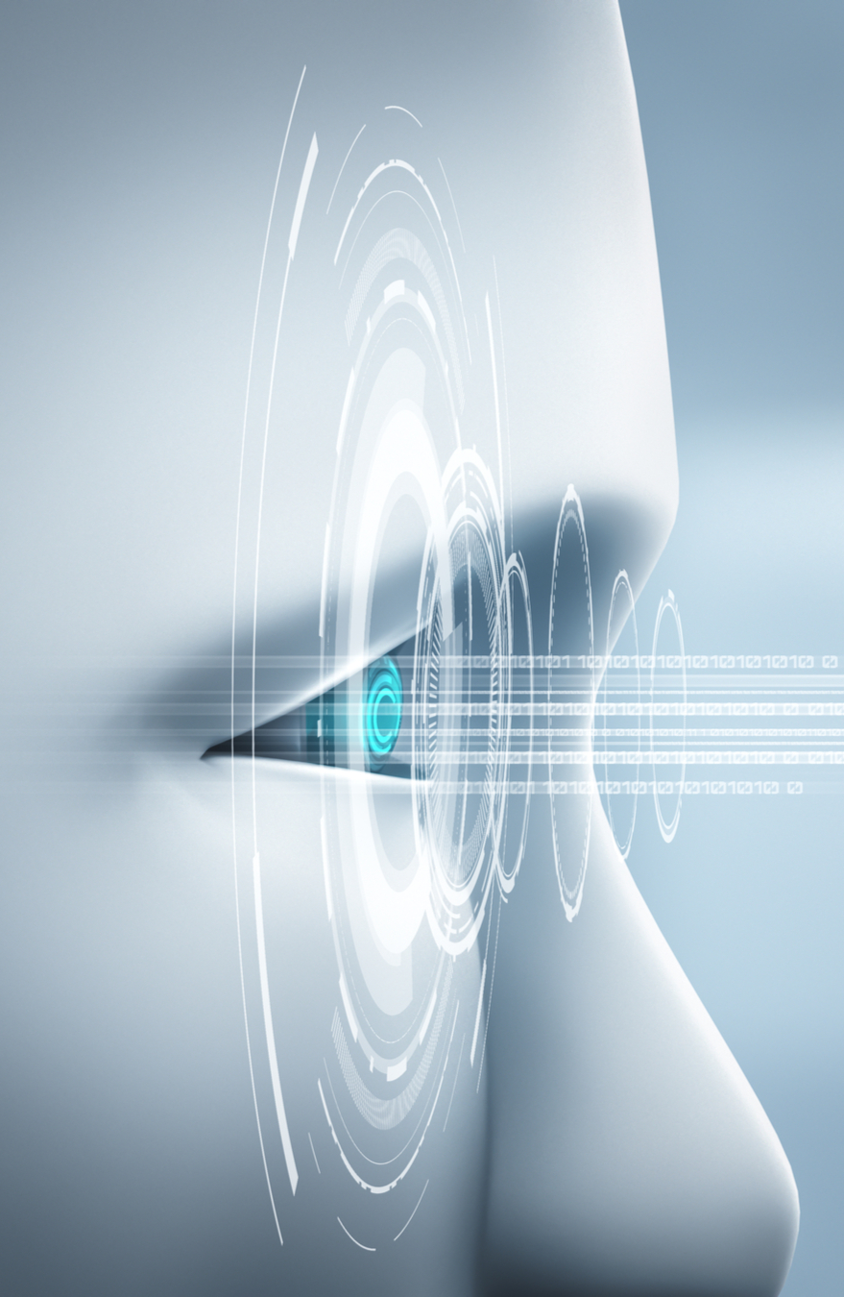
Computer Vision Applications
By Quadeer Shaikh

Slide 2

About me
Work Experience
Risk Analyst
Morgan Stanley (Jan 2023 – Present)
Data Science Intern
AkzoNobel Coatings International B.V. Netherlands (Feb 2022 – Dec 2022)
Data Science Intern
EzeRx Health Tech Pvt. Ltd. (Jan 2022 – July 2022)
Associate Engineer
Tata Communications Ltd. (July 2019 – Aug 2020)
Network Automation and Analysis Engineer Intern
Cisco (June 2018 – July 2018)
Education
M.Tech – Artificial Intelligence
NMIMS (2021 - 2023, currently pursuing)
B.E. – Computer Engineering
Mumbai University (2015 - 2019)

Slide 3
The Deep Learning Era

Slide 4
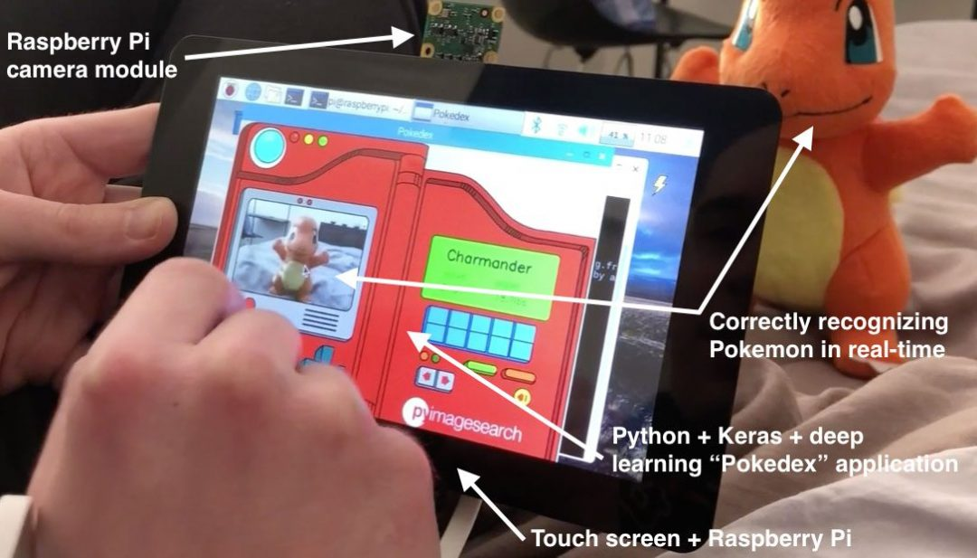
Deep Learning Phase Outline
A revisit to an old friend: Neural Networks
A visit to a new friend: Convolutional Neural Networks (CNNs)
Image Augmentation
Optimization and Improvement of CNNs
Diagnosis of CNNs
CNNs Architectures and Transfer Learning
AlexNet
VGG16/19
InceptionNet/GoogleNet
ResNet
MobileNet
EfficientNet

Slide 5

Deep Learning Phase Outline
What do CNNs Learn ?
One Shot Learning (Face Recognition)
Siamese Network
Image Segmentation
FCN
U-Net (Optional)
Object Detection (Architecture details and training framework)
RCNN
Fast RCNN
Faster RCNN
YOLO

Slide 6
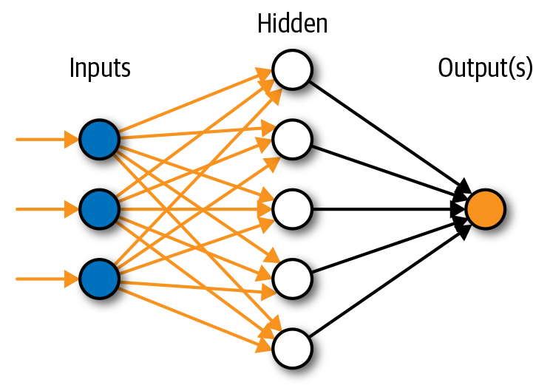
A revisit to an old friend: NNs
An ANN is based on a collection of connected units or nodes called artificial neurons, which loosely model the neurons in a biological brain
Used for non linear pattern recognition
Always count the hidden layers + output layers
This is a 2 layers neural network
Hyperparameters need to be configured:-
No. of layers
No. of neurons in each layer
No. of epochs
Learning rate
Loss function, Optimizer
Batch size
How do you count the total parameters in your neural network ?

Slide 7
A revisit to an old friend: NNs
How do you calculate the total parameters in the neural network ?
Ans. A neural network has 2 kind of params: weights and biases
Params for a given layer l
Weights = No. of units in current layer (l) x No. of units in prev layer (l-1)
Biases = No. of units in current layer (l) x 1
Params = no. of weights + no. of biases

Slide 8
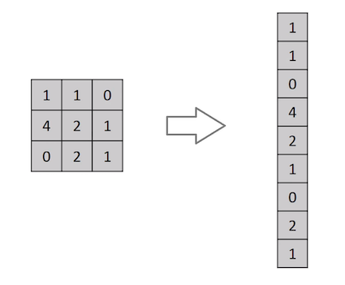
A revisit to an old friend: NNs
How to perform image classification using ANNs ?
Flatten the image
Pass the flattened image to the neural network
Problems with this for image related tasks:-
Images have a 2D spatial structure, therefore considering only the flattened pixel values are not very useful features for tasks like classification
Pixels that spatially separated are treated the same way as pixels that are adjacent
No way for network to learn features at different places in an input image
Imagine flattening an image of resolution 224x224x3, every image will be represented using a vector of size 150,528.
Now imagine using a neural network which has 2 hidden layers of 512 and 128 neurons each and one output layer of 1 neuron. Can you calculate the number of parameters required ?
Params
512 x 150,528 + 512 x 1 = 77,070,848
128 x 512 + 128 x 1 = 65,664
1 x 128 + 1 x 1 = 129
Total = 77,136,641

Slide 9
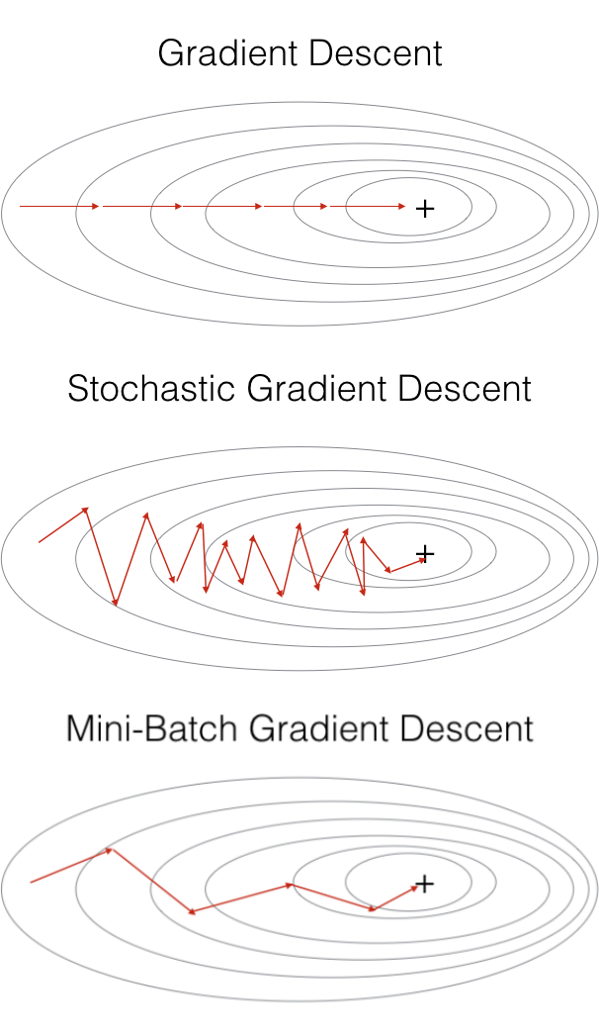
A revisit to an old friend: NNs
Fantastic optimization algorithms and how to use them
Batch Gradient Descent
A misleading name given by the ML community, the batch gradient descent updates the weight of the neural network by performing forward & backward propagation on the entire dataset i.e. all the training samples/records in a single epoch/iteration
Stochastic Gradient Descent
In batch gd we consider all the training records, but what if the training dataset is huge. You cannot fit huge amount of data into your memory (RAM) for the training process. We take one example each time from the records to update the weights using forward-backward prop (done for all records one by one in an entire epoch). Cost fluctuates a lot during the minimization and starts decreasing in the long run. Has a problem with convergence to minima.
Mini Batch Gradient Descent
SGD has a minima convergence problem and also cannot be implemented with vectorized computation (due to one sample taken each time for a forward-backward prop. Therefore we take mini batches from the dataset and update the weights repeatedly batch wise for an entire epoch. Convergence to minima is smoother than SGD.
Other optimizers like RMSProp, AdaGrad, Adam, etc also use mini batch implementations

Slide 10
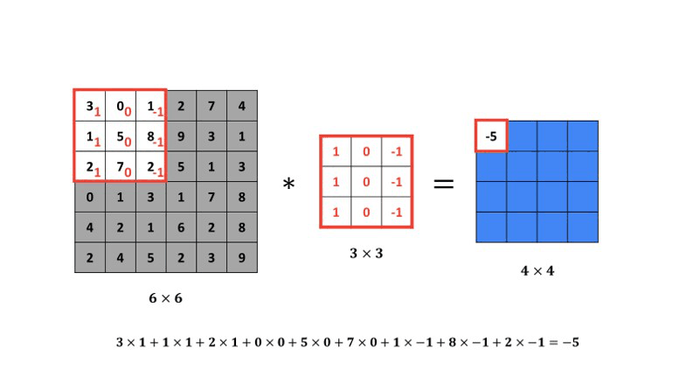
A visit to a new friend: CNNs
Remember Convolution operation ?
Kernels/Filters were used to detect features in an image by convolving them on the image
How to decide weights of kernels ?
Make the kernels learnable
Treat the kernels as trainable weights
What about nonlinear patterns in images ?
Add activation functions to the kernels

Slide 11
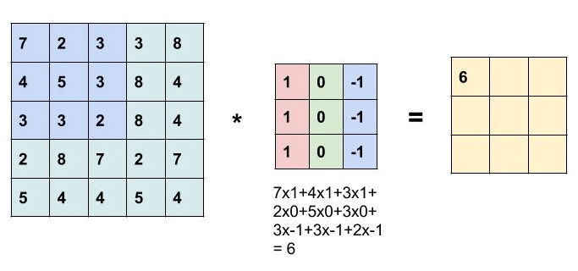

CNNs: Understanding Dimensions
Lets just consider the W1 and H1 for now. Suppose we have an image of size 5x5 (W1xH1) and kernel of size 3x3.
The result of convolution is 3x3
W2: W1 – F + 1 -> 5 – 3 + 1 = 3
H2: H1 – F + 1 -> 5 – 3 + 1 = 3
Lets say we have a 7x7 image and kernel of size 3x3
7 – 3 + 1 = 5
Note: The output result dimensions are smaller than input dimensions

Slide 12
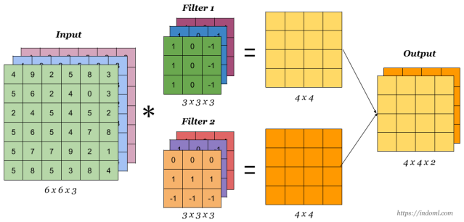
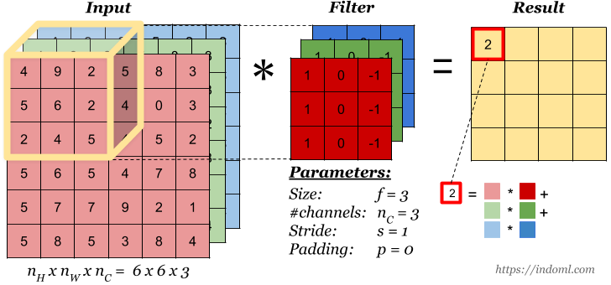
Convolutions over Volumes
Convolutions on RGB image/over volumes
Note: Filter/Kernel depth should be the same as input image depth

Slide 13
CNNs: Understanding Dimensions
Input Dimensions: Width (W1) x Height (H1) x Depth (D1) [e.g. 224x224x3]
Spatial Extent of Filter/Kernel: F (depth of the filter is same as of input)
Output Dimensions: W2 x H2 x D2
Strides: S
Kernels: K
Padding: P

Slide 14
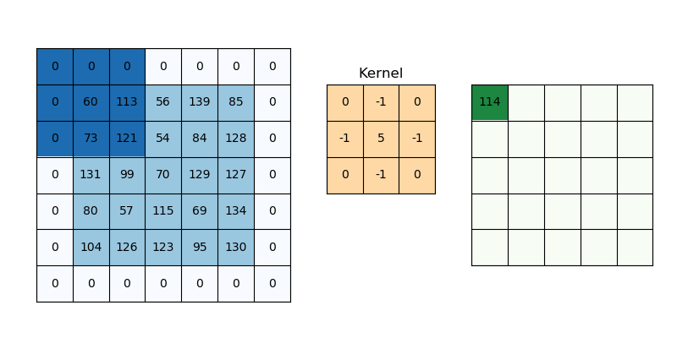
CNNs: Understanding Dimensions
What if we want the output of convolution to be of same size as input ?
Pad input image with appropriate number of inputs so that you can now apply the kernel on input image corners as well. There are different methods for padding but the most commonly used one is zero padding. No. of Padding units (P)
If P is set to 1 then it will pad rows and columns of 0’s to the top, bottom, left and right of the image
W2: W1 – F + 2P +1, H2: H1 – F + 2P +1
5 – 3 + 2x1 + 1 = 5

Slide 15
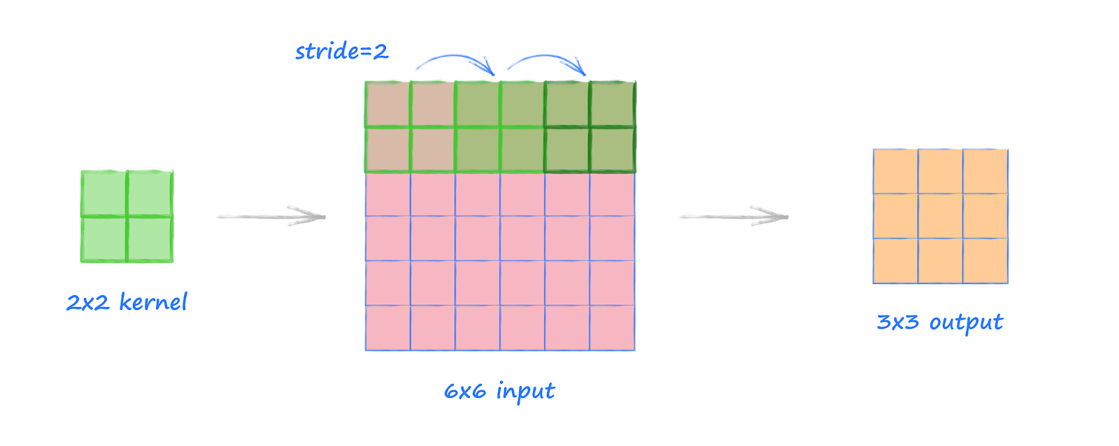
CNNs: Understanding Dimensions
What does stride do ?
Defines the intervals at which the kernel is applied to the image
Results in an output of smaller dimensions
W2: [(W1 – F + 2P)/S] + 1
H2: [(H1 – F + 2P)/S] + 1
6x6 image, 2x2 kernel and stride 2
[(6 – 2 + 2x0)/2] + 1 = 3

Slide 16
CNNs: Understanding Dimensions
Lets talk about the depth of the output now.
Each kernel/filter gives us a 2D output
If we use K filters then we will get K such 2D outputs
The resulting dimensions would then be W2xH2xK
Thus, D2 = K
1

Slide 17
What were the challenges faced by ANNs aka FNNs in image tasks ?
Problems with this for image related tasks:-
Images have a 2D spatial structure, therefore considering only the flattened pixel values are not very useful features for tasks like classification
Pixels that spatially separated are treated the same way as pixels that are adjacent
No obvious way for network to learn features at different places in an input image (similar edges, corners or blobs)
Can get computationally expensive for large images

Slide 18

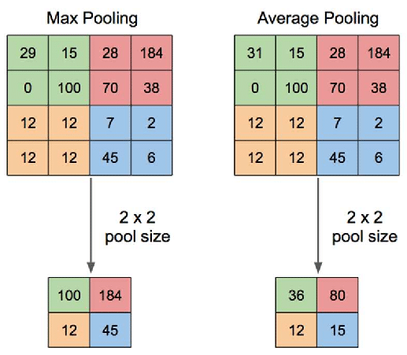
How do CNNs solve these challenges ?
Local Receptive Fields: Hidden units are connected to the local patches from the previous layer. This serves 2 main purposes:-
Captures local spatial relationships in pixels
Reduces the number of parameters significantly
Weight Sharing: Also serves 2 purposes
Enables rotation, scale and translational invariance to objects in images (no more usage of the painful SIFT algo)
Reduces number of parameters in the model
Pooling: condenses info from previous layer
Aggregates info, especially the minor variations
Reduces size of output from previous layer, which reduces the number of computations in the previous layer

Slide 19

What a typical CNN architecture looks like ?

Slide 20
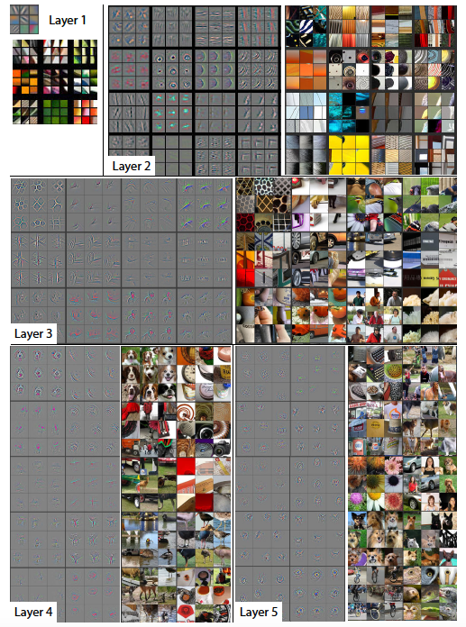
How do CNNs go about learning patterns ?

Slide 21
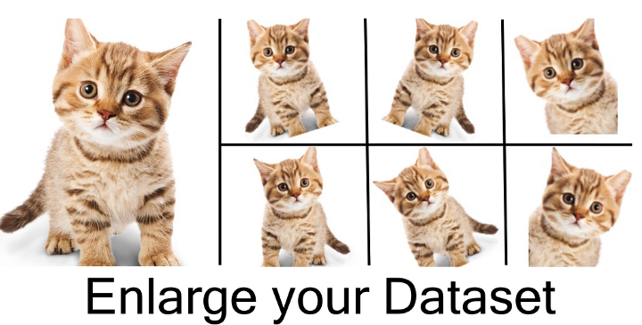
Image Augmentation
Image augmentation is a technique that is used to artificially expand the data-set. This is helpful when we are given a data-set with very few data samples. In case of Deep Learning, this situation is bad as the model tends to over-fit when we train it on limited number of data samples.
We use both image filtering and image transformations (affine transformations) to expand the dataset.
Since we know that the weight sharing property of the CNNs make the network rotation, scale and translational invariant we can easily leverage these transformation methods.

Slide 22
Diagnosis of CNNs
Use Classification Metrics
Observe the high and low probability scores
Observe the feature maps
Extract the features from the second last layer
Perform 2D or 3D plots to visualize them in the x-y(z) coordinate space
Requires dimensionality reduction
Advanced visualization methods
Maximal activated image patches
Gradient based class activation maps

Slide 23
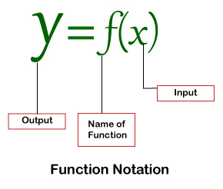
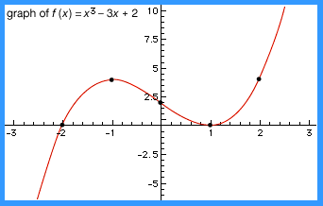
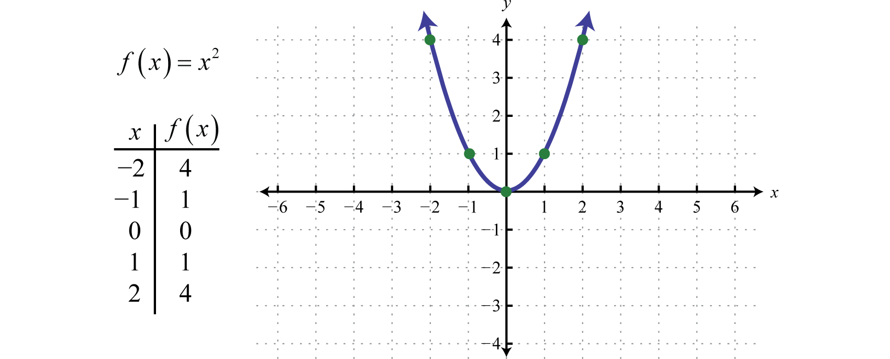
Neural Networks as Functions

Slide 24
Neural Networks as Functions
Note: Neural Networks are nothing but trainable parametric non linear functions. The complexity of the function depends on the number of layers of the neural network

Slide 25
Overfitting in Neural Nets
What happens when a function is overtrained on same instances of data ? It overfits on those values and fails to generalize on new instances of data.
Solution: -
Regularization
L1 and L2, ElasticNet
Dropout
Addressing the difference in data distributions
Adding more data (diverse kind not the repeated instances)
Stop being greedy and stop the training a little earlier

Slide 26
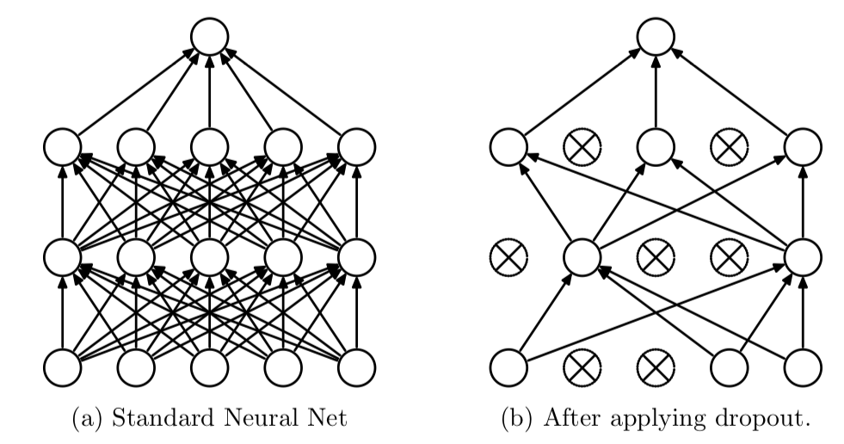
Dropout
The term “dropout” refers to dropping out the nodes (input and hidden layer) in a neural network. All the forward and backwards connections with a dropped node are temporarily removed, thus creating a new network architecture out of the parent network. The nodes are dropped by a dropout probability of p. E.g. if a hidden layer has 8 neurons and the dropout rate p is 0.5, then 4 neurons will be randomly dropped of from that hidden layer.
Another way to think of it is to realize that a unique neural net is generated at each training step. The final neural network during the inference time will be nothing but the average ensemble of these smaller reduced neural nets. It has the same intuition as Random Forest.

Slide 27
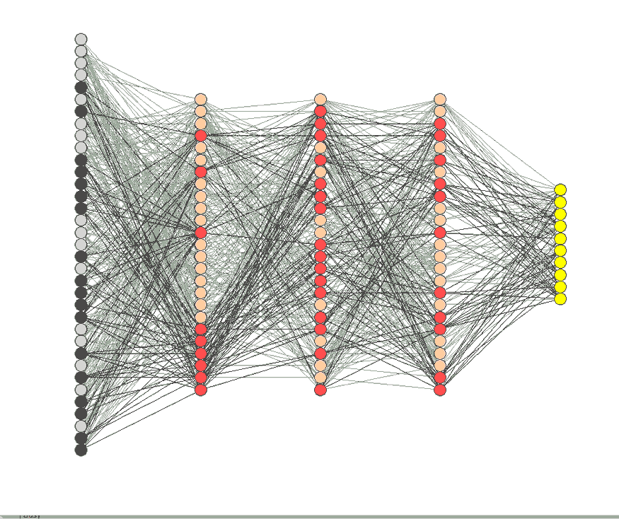
Dropout
Dropout solves the problem of overfitting which is prominently caused by the problem of co-adaptation.
In neural network, co-adaptation means that some neurons are highly dependent on others. If those independent neurons receive “bad” inputs, then the dependent neurons can be affected as well, and ultimately it can significantly alter the model performance, which is what might happen with overfitting.

Slide 28
Dropout During Inference (Test/Val)
During inference (testing/validation) dropout layer is not used. This means that we consider all the neurons of the original/parent neural network. But due to this the final weights of the neural network will be larger than expected. Therefore the weights are scaled by multiplying p the dropout rate with the weights for each unique neurons dropped out neural network and then summed together to get the final weights of the neural network at inference time.

Slide 29
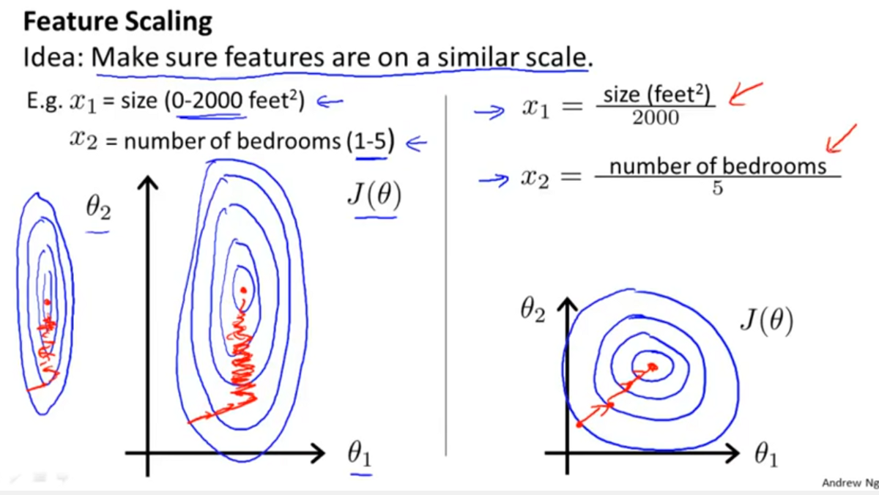
Why Feature Scaling is Important ?
We need input feature scaling in parametric methods like neural networks because the parameters descend quickly on smaller homogeneous scales and slowly on larger heterogeneous scales.
But what about the scales of features of the hidden layers of the neural network ?

Slide 30
Internal Covariate Shift
“We define Internal Covariate Shift as the change in the distribution of network activations due to the change in network parameters during training.” – Authors of Batch Normalization: Accelerating Deep Network Training by Reducing Internal Covariate Shift.
In neural networks, the output of the first layer feeds into the second layer, the output of the second layer feeds into the third, and so on. When the parameters of a layer change, so does the distribution of inputs to subsequent layers.
These shifts in input distributions known as Internal Covariate Shifts can be problematic for neural networks, especially deep neural networks that could have a large number of layers.

Slide 31
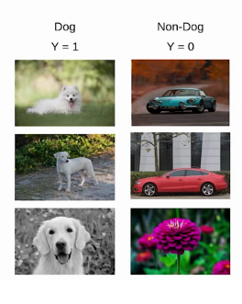
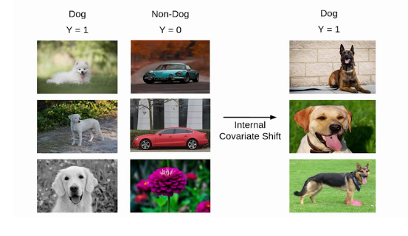
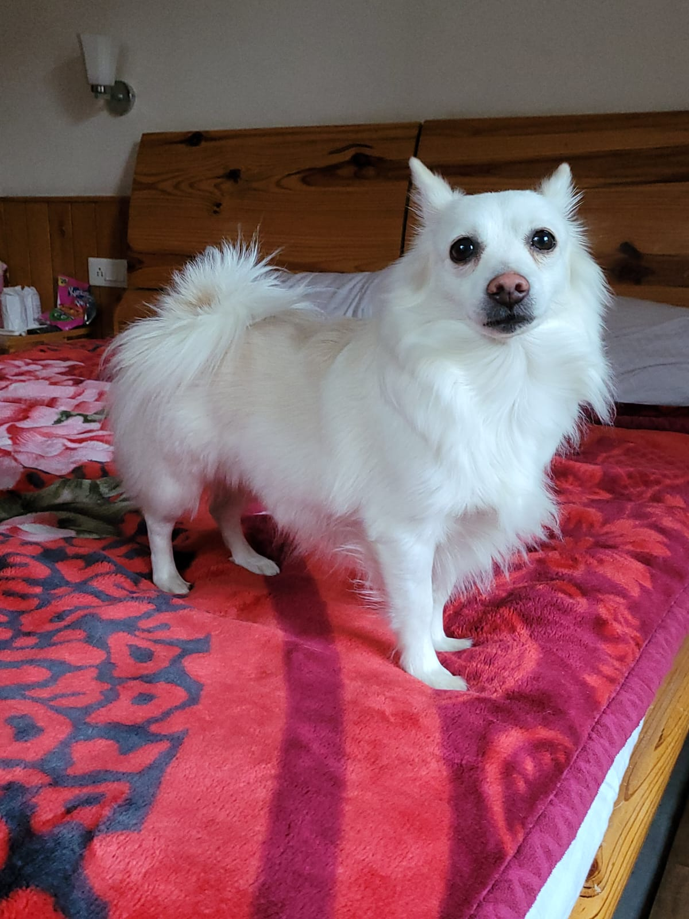
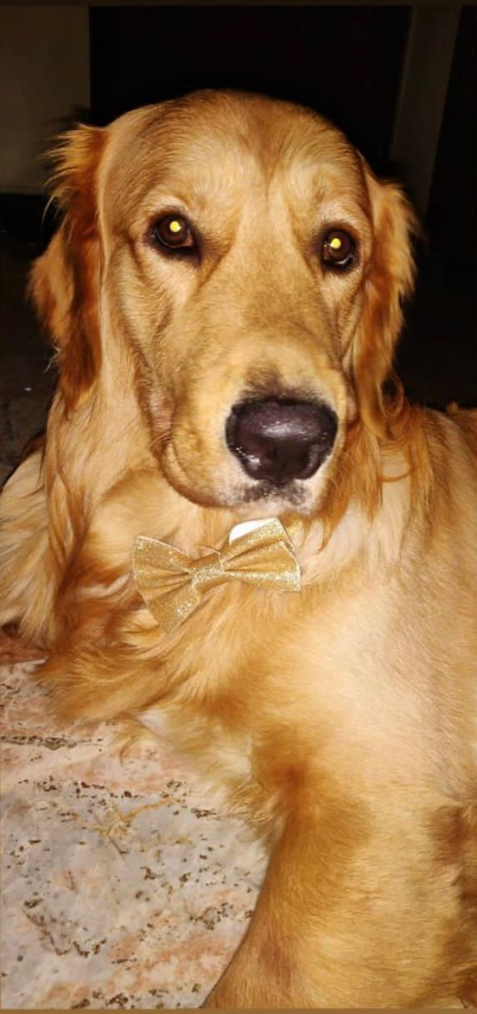
Example of Internal Covariate Shift
Lets say we are solving a binary classification problem of Dogs vs……. Not Dogs ?
Let’s say we have the images of white dogs only in a certain batch, these images will have certain distribution as well. Using these images model will update its parameters.
Later when we introduce a new set of images consisting of not white dogs, they will have a different distribution from the previous images.
Coco: *wut the floof, demn you internal covariate shift*
Hope: *hemk I is part of distribn*

Slide 32
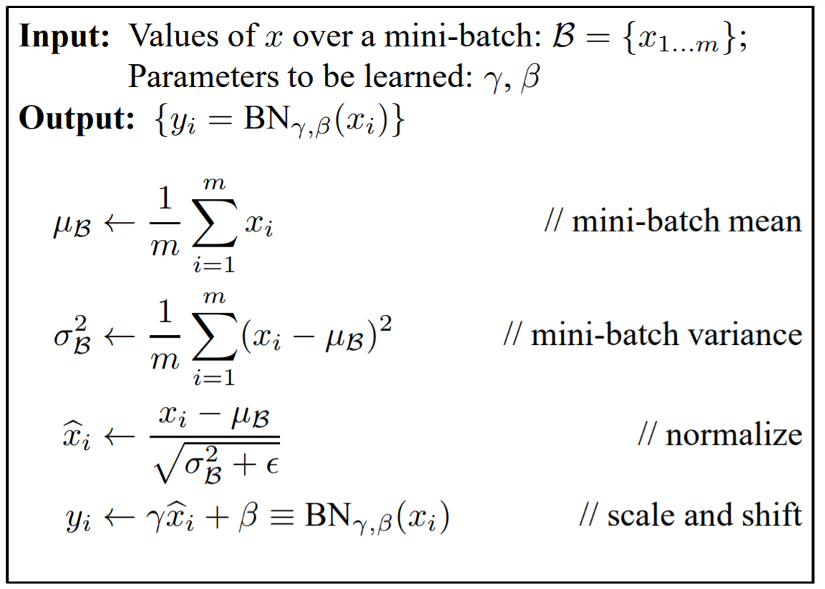
Batch Normalization
This technique adds an operation in the model before or after the activation function of each hidden layer.
This operation simply zero centers and normalizes each input then scales and shifts the result using two new parameter vectors per layer
One for scaling
The other for shifting

Slide 33
Batch Normalization during Testing/Validation
During Training Batch Normalization standardizes intermediate inputs, then rescales and offsets them.
What about Test/Validation Time ?
We may be passing just one instance of image at test time, or maybe a smaller batch of images so we may have no way to compute mean and SD or we may have to compute the mean and SD over a smaller batch/sample.
Most DL frameworks estimate the mean and SD for test and validation by performing a moving average of layer’s input means and SD then uses this mean and SD for BatchNormalization during the test/validation

Slide 34
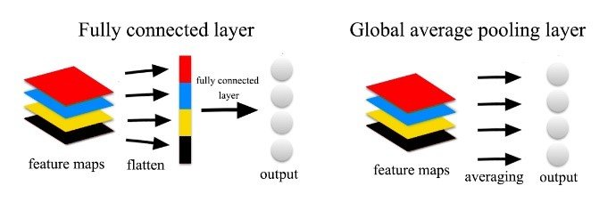
Global Average Pooling
Reduces the increase in number of params caused by flattening layer
Takes an average of all the feature maps of the layer
E.g. if the last conv layer in the network has 512 filters thus producing 512 feature maps, the global average pooling will produce an output vector of 512

Slide 35
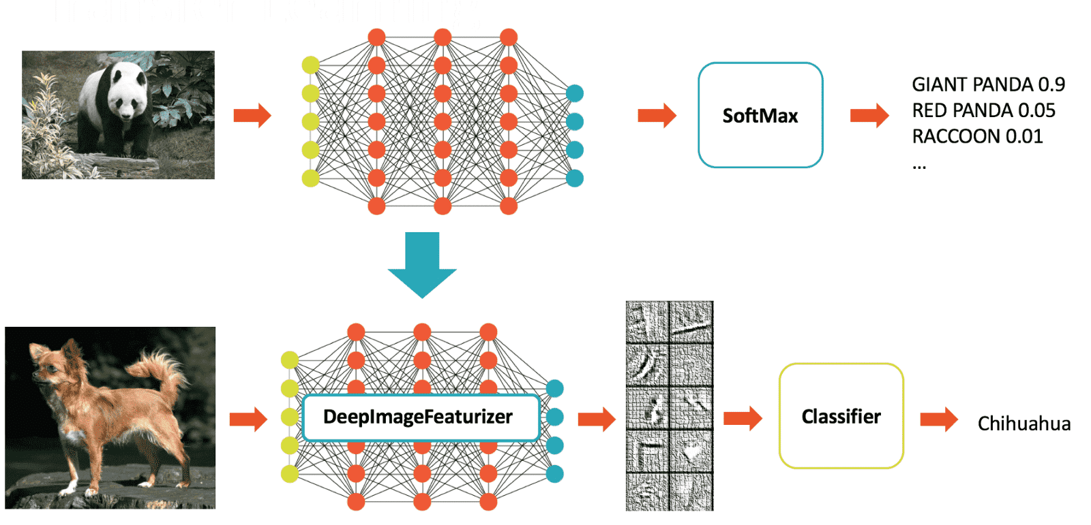
Transfer Learning

Slide 36
Transfer Learning
Transfer Learning is the transfer of the knowledge (feature maps) that the network has acquired from one task, where we have large amount of data, to a new task where the data is not abundantly available.
Generally used where a neural network model is trained on a problem similar to the problem that is being solved.
The intuition behind transfer learning is that if a model is trained on a large and general enough dataset, the model will effectively serve as a generic function for that problem.
We use the feature maps that this model has learnt, and without having to train a new model on a large dataset we can transfer the learning of the trained model’s knowledge to our model and use it as a base starting model for our own task

Slide 37
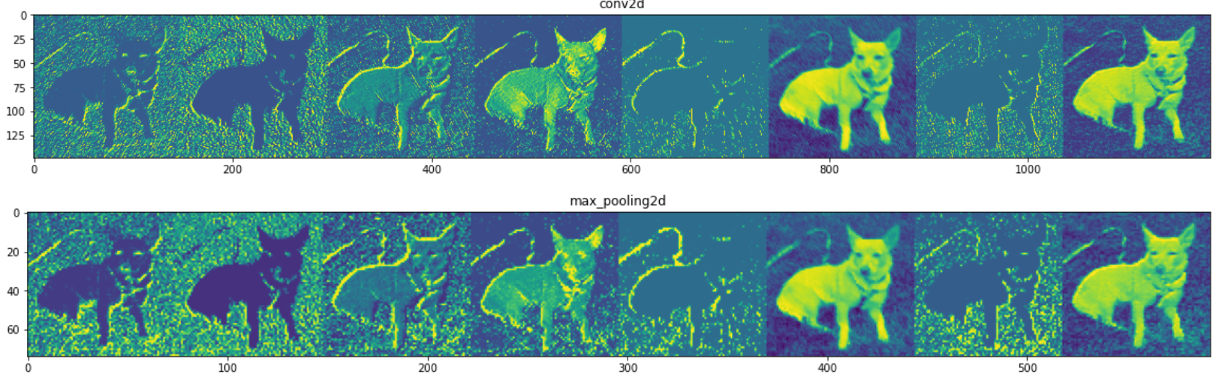
How Transfer Learning works ?
What is really being learned by a CNN during training ? Feature Maps
How are these features learned ? During backpropagation process the weights are updated until we get to the optimized weights that minimize the error function
What is the relationship between features and weights ? Feature maps are a result of passing the weights filter/kernel on the input image during the convolution process
What is really being transferred from one network to another ? To transfer features we use the optimized weights of the pretrained network and reuse them as the starting point for the training process to adapt to our new problem

Slide 38
One Problem to Rule them all: ImageNet
ImageNet Large Scale Visual Recognition Challenge
The ImageNet Large Scale Visual Recognition Challenge (ILSVRC) evaluates algorithms for object detection and image classification at large scale. One high level motivation is to allow researchers to compare progress in detection across a wider variety of objects -- taking advantage of the quite expensive labeling effort. Another motivation is to measure the progress of computer vision for large scale image indexing for retrieval and annotation.

Slide 39
Transfer Learning Approaches
Using a pretrained network as a classifier
Using a pretrained network as a feature extractor
Finetuning

Slide 40
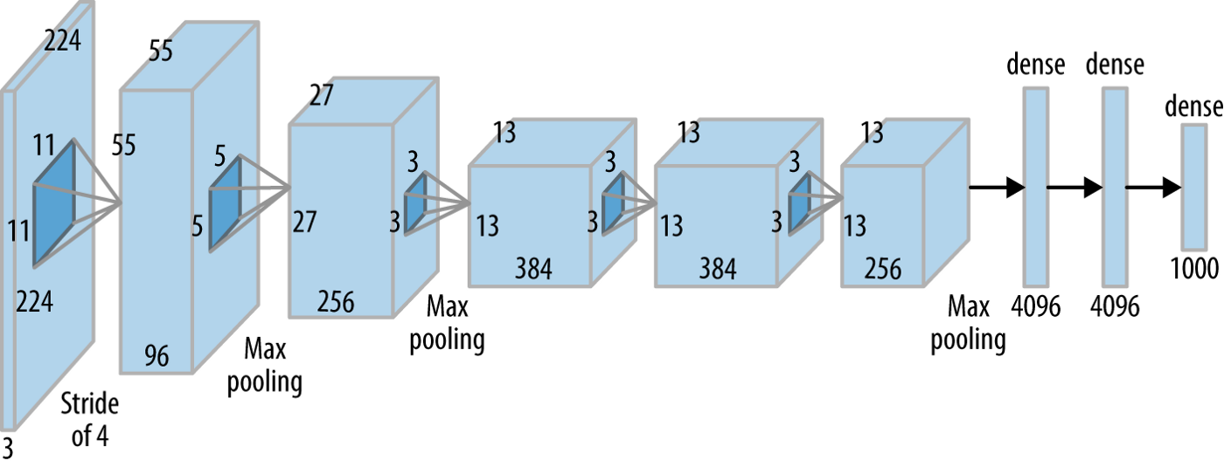
AlexNet

Slide 41
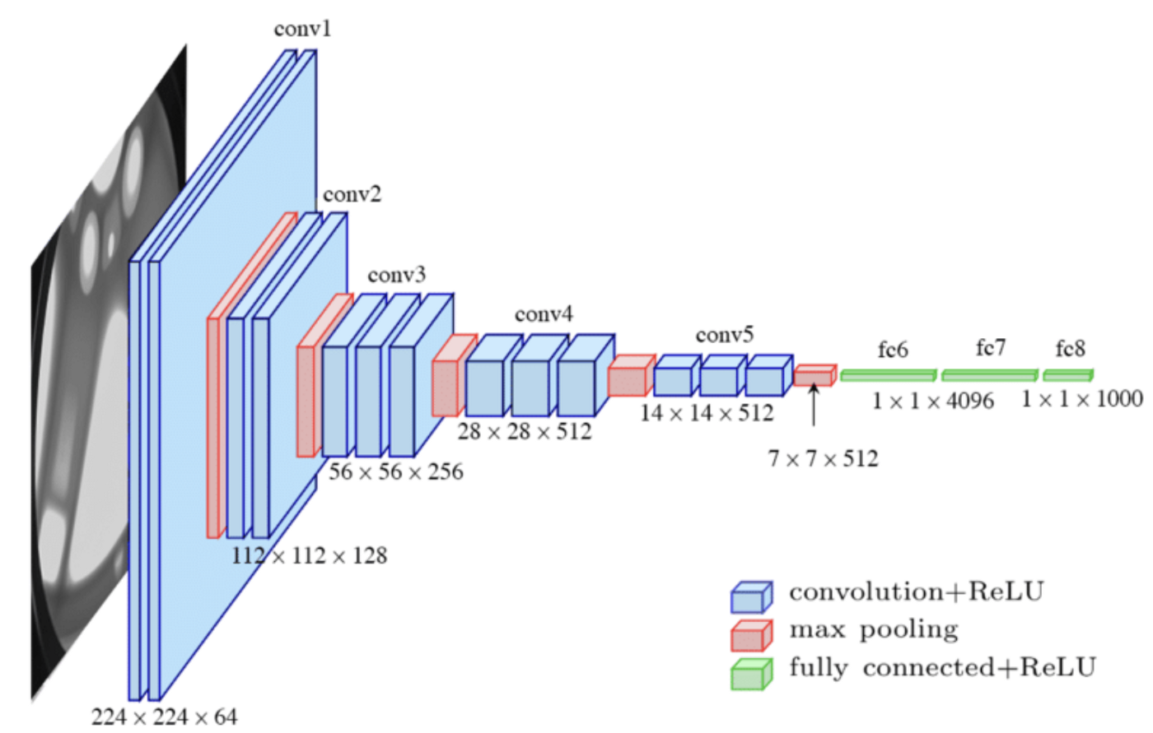
VGG-16

Slide 42
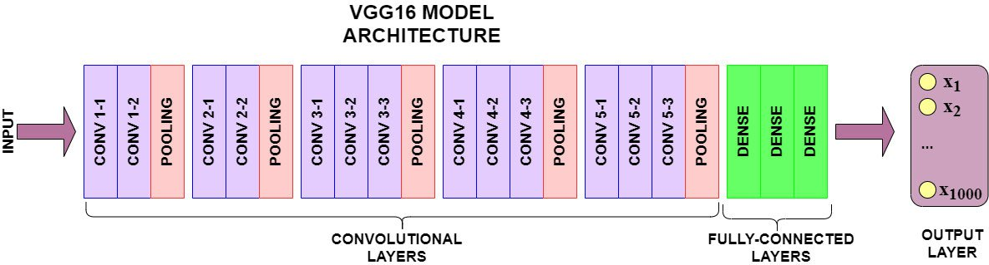
Pretrained Network as a Classifier
Produces the class output from the data labels it has been trained on

Slide 43
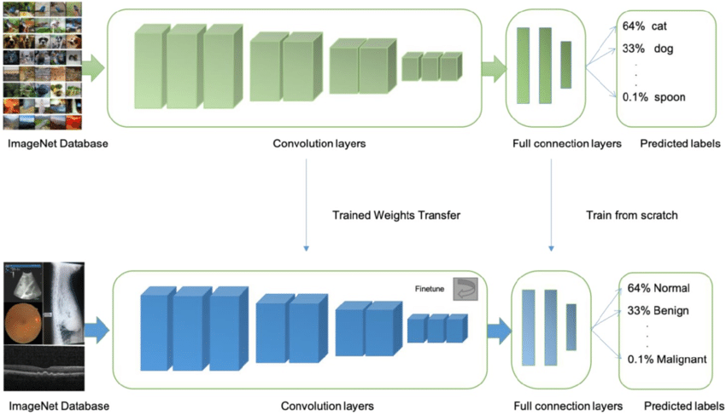
Pretrained Network as a Feature Extractor
Use the convolutional layers of the trained model to extract features
Remove the classifier of the pretrained network and add your own classifier
Add a classifier on top, fully connected layers + decision neuron
Freeze the layers and use pretrained weights

Slide 44
Pretrained Network as a Feature Extractor
Use the convolutional layers of the trained model to extract features. What if you could use some other classifier instead of a fully connected layers + decision neuron (which is basically a NN) ? What if you could use a Naïve Bayes, SVM, RandomForest or a XGBoost Classifier
SVM
Naïve Bayes
Random Forest
XGBoost
Etc.
Freeze the layers and use pretrained weights
Add a classifier on top

Slide 45
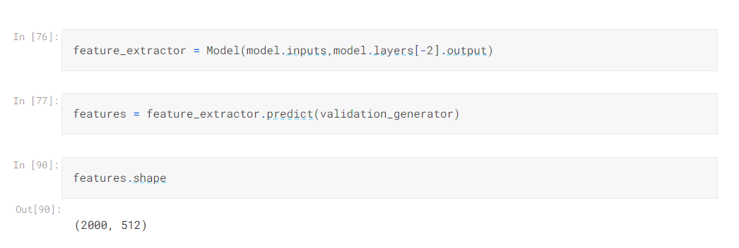
Pretrained Network as a Feature Extractor
Use the image embeddings extracted from the pretrained network and build a tabular dataset
Use the target labels and these extracted features to train the classifier model like you usually do

Slide 46
Fine Tuning
So far we have seen how to use a pretrained network directly for classification or as a feature extractor. We generally use these approaches when the domain of the target dataset (problem we are interested in solving) is somewhat similar to the source domain (imagenet problem)
But what if the target domain is different from the source domain or if its very different ?
We just extract the correct feature maps from the source domain pretrained network and fine tune them to the target domain. This is known as fine tuning.
Fine tuning can be formally defined as freezing a few of the network layers that are used for feature extraction and transferring all of its high level feature maps (outputs of later convolutional layers) to your domain.

Slide 47
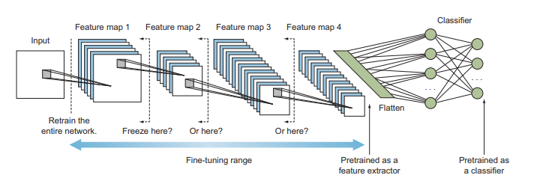
So how many layers should we freeze ?

Slide 48
Choosing the appropriate level of Transfer Learning
Choosing the level of transfer learning depends on two important factors:-
Size of the target dataset (small or large): When we have a small dataset, the network probably won’t learn much from training on larger number of layers, so it will tend to overfit the new data. In this case we want to rely more on the pretrained weights of the source dataset
Domain similarity of the source and target datasets: Is the target problem similar or different than the source problem ?
These two factors lead to 4 different scenarios

Slide 49
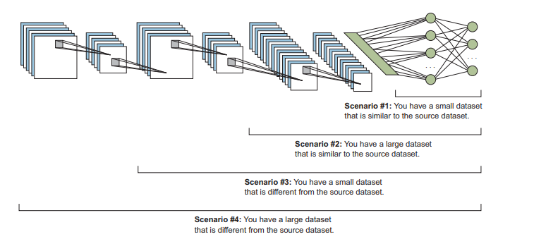
Choosing the appropriate level of Transfer Learning

Slide 50
Choosing the appropriate level of Transfer Learning
Scenario | Size of the target data | Similarity of the original and new datasets | Approach
1 | Small | Similar | Use pretrained network as a feature extractor
2 | Large | Similar | Freeze 60-80% of the network and fine tune the rest of the network
3 | Small | Very Different | Since target dataset is different it might not be the best to freeze the higher level features of the pretrained network because they contain source dataset specific features. It will be better to retrain layers from somewhere early in the network. Freeze 30-50% of the network.
4 | Large | Very Different | Fine tune the entire network/Train the entire network by using the existing weights of the pretrained network

Slide 51
Transfer Learning and Learning Rates
Note: Learning rates should be kept small when transfer learning is applied, reason being you do not want the trainable layers’ weights to change drastically during your training process.

Slide 52
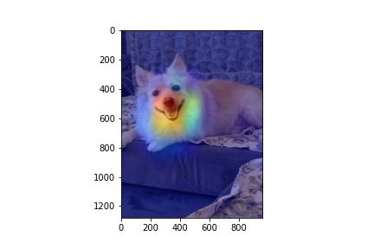
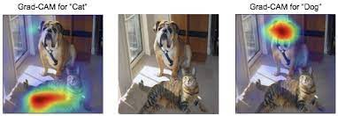
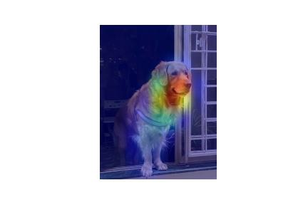
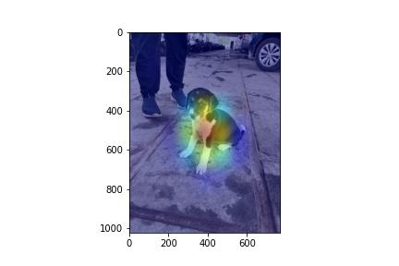
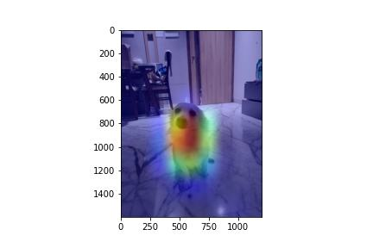
Grad-CAM: What do CNNs learn?

Slide 53
Miscellaneous

Slide 54
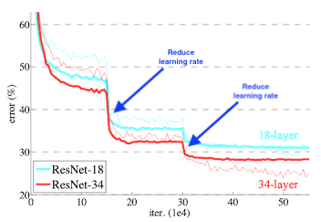
Model Callbacks
EarlyStopping
Checkpointing
ReduceLROnPlateau

Slide 55
ROC and AUC
https://towardsdatascience.com/demystifying-roc-curves-df809474529a
https://towardsdatascience.com/understanding-auc-roc-curve-68b2303cc9c5

Slide 56
Thank you
For any queries drop an email at: quadeershaikh15.8@gmail.com

